Slide 1

Making this resource work for you
Prior to teaching this lesson, please refer to the ‘Unit Overview and Planning Document’.
Further guidance on planning Science Mastery lessons can be found in the detailed planning guidance document.
Refer to the ‘notes’ section on each slide for useful information, including suggested expositions, pedagogical content knowledge, suggested questions, answers and more. Consider using presenter mode so you can see this guidance throughout the lesson.
The introduction slides can be adapted to suit your teaching style and the needs of your class.
Before the lesson, adapt the fix-it slide to address any misconceptions identified in the previous lesson’s exit ticket.
Choose from the suggested activities to suit your class. The intention is not that you complete all of these, but that you select those which ones are most appropriate for your students. It may be appropriate to further adapt activities for your students.
These lessons are designed to occupy approximately 1 hour. To adapt for a shorter or longer lesson duration we advise you to adapt the activity section accordingly.
Please consider using the final slide to send feedback about this lesson or examples of PowerPoints that you have adapted to our design team. Your feedback is used to improve Science Mastery for all of our teachers and students. We appreciate all suggestions and comments.
Thank you for reading!
The Science Mastery Team

Slide 2


Acceleration Problems
Answer the following questions:
State the equation used to calculate acceleration.
State the SI unit for acceleration.
Explain why acceleration is a vector quantity.
Compare the meaning of a horizontal line on a distance-time graph and a velocity-time graph.
Name the quantity that can be determined from the gradient of a velocity-time graph.
$$Acceleration= \frac{Change in velocity}{Time}$$
Metres per second squared (m/s²)
Acceleration is the rate of change of velocity and velocity is speed in a given direction, so acceleration must also have a direction.
On a distance-time graph a horizontal line represents a stationary object whereas on a velocity-time graph a horizontal line represents an object with constant velocity.
Acceleration
Notes:
Foundation question: What does a horizontal line on a velocity-time graph represent?
Answer: Constant velocity (an object with no acceleration/same velocity).
Stretch question: Compare and contrast the features of distance-time graphs and velocity-time graphs.
Answer:
Compare (similarities) – both describe the motion of objects, both have time on the x axis
Contrast (differences):
distance-time graph has distance on the y axis, velocity-time graph has velocity on the y axis
horizontal line on d-t graph means a stationary object, on v-t graph means constant speed
gradient on d-t graph is speed, gradient on v-t graph is acceleration
positive gradient on d-t graph is constant speed, on v-t graph it is uniform acceleration
negative gradient on d-t graph is returning to position (travelling in opposite direction), on v-t graph is deceleration

Slide 3
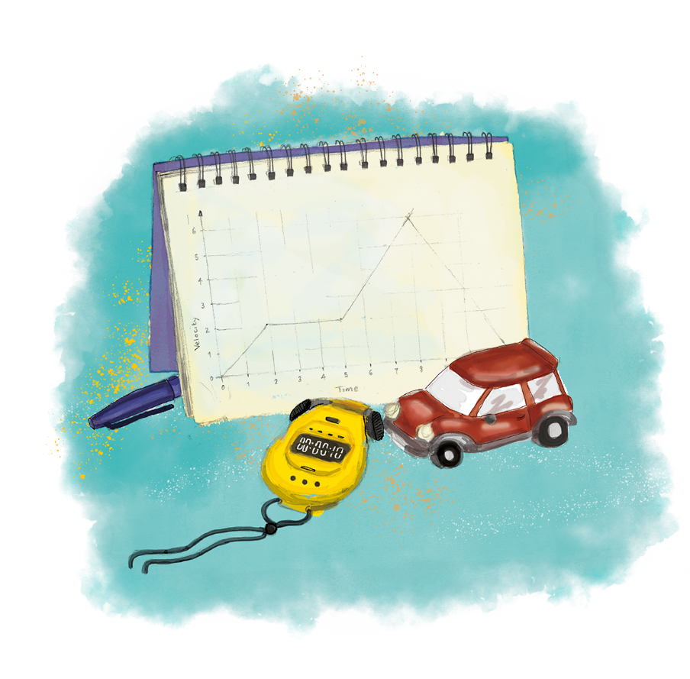


P3.1.11
11/02/2025
Acceleration Problems
P3.1.1 Prior Knowledge Review
P3.1.2 Scalars and Vectors
P3.1.3 Resultant Vectors
P3.1.4 Resolving Vectors
P3.1.5 Newton's Third Law
P3.1.6 Newton's First Law
P3.1.7 Acceleration
P3.1.8 Acceleration Investigation
Maths in Science Lesson 17
P3.1.9 Velocity-Time Graphs
P3.1.10 Velocity-Time Graphs 2
P3.1.11 Acceleration Problems
Notes:
The final lesson of this unit will look at further consolidating the links between forces and motion, particularly when applied to velocity-time graphs. The main activity of this lesson is applying this knowledge in a new context (looking at vertical motion) and considering the forces acting on a rocket. This will bring together pupils’ knowledge of balanced and unbalanced forces, acceleration and velocity-time graphs.
Hook:
What would a velocity-time graph look like for a rocket taking off?
Pupils could be asked to sketch this and discuss their reasoning.

Slide 4

Following this lesson, students will be able to:
Describe the motion of an object using a velocity-time graph
Use a velocity-time graph to draw conclusions about the forces acting on an object
Key Words:
force
balanced
unbalanced
velocity
acceleration
vertical

Slide 5
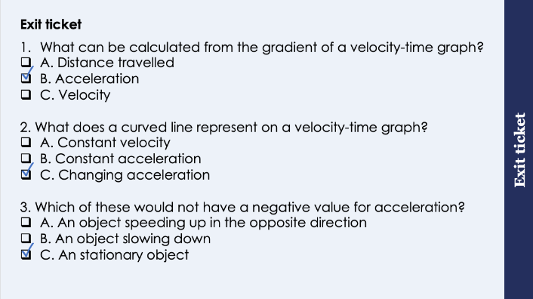
This is the fix-it portion of the lesson
The fix-it is an opportunity to respond to gaps in knowledge, especially those identified by the previous lesson’s exit ticket.
The teacher should customise this slide as needed, to facilitate
reteach, explanation, demonstration or modelling of ideas and concepts that students have not yet grasped or have misunderstood.
practise answering specific questions or of key skills.
redrafting or improving previous work.
Notes:
Suggested Guidance:
Q1. Answer: B
If students answer A they may have confused gradient with area under the graph. If students answer B they may have confused VT and DT graphs. To fix-it pupils can practice calculating acceleration from the gradient at different points on a VT graph.
Q2. Answer: C
If students answer A they have not understood the significance of the horizontal line on a VT graph. If students answer B they may not understand the difference between constant and changing acceleration. To fix-it you may want to go through a curved section of a graph and calculate the gradient at different points to illustrate to pupils that the acceleration is not constant.
Q3. Answer: C
If students answer A or B they have not understood the meaning of a negative value for acceleration. To fix-it you may want to model calculations of the scenarios in A and B to show how you arrive at a negative value for acceleration.

Slide 6
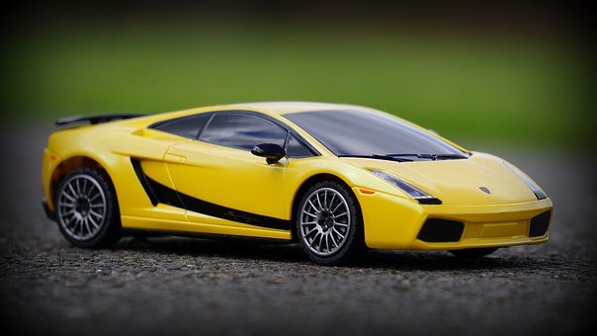

Why do all cars have a top speed?
What is a top speed?
Which of these cars would have a greater top speed?
What would affect the top speed of these cars?
Notes:
Guidance:
This is an area of physics that overlaps with real life in a very obvious way, so can be a very engaging topic for students. You may want to give students these images and ask them to try and explain what a top speed is and why the sports car would have a greater top speed. Most pupils will be able to explain that it is because of the power of the engine being much greater so guide them towards explaining this in terms of a thrust force. Some pupils may also be able to explain that the shape of the car makes it faster but struggle to articulate why.
Suggested guidance:
Talk tasks can be used in a variety of ways to suit the particular needs of the students you are teaching. Through exchanging views with others, students develop their understanding of the science beyond what could be achieved individually.
Science classrooms that successfully integrate talk have the following features:
Science talk is a regular feature of lessons and is woven into classroom activities.
Students are paired or grouped strategically by the teacher to ensure productive interaction. This might take into consideration the students’ proficiency of the English language, how encouraging they might be to peers and their attainment in the topic. It’s a good idea to consider these pairings in the class seating plan.
Students are encouraged and supported to talk, but are not forced to talk.
The teacher should take on the role of a facilitator, engaging with conversations where necessary and encouraging or steering the conversation where needed.
Students are encouraged to use the language they have to express their ideas (e.g., everyday language, imperfect English, native language), but also to incorporate science specific terminology where this is more accurate or has been taught.
6. Scientifically inaccurate ideas are not dismissed by the partner or teacher; open discussion and further investigation are relied on to help students construct ideas that support them to progress in their scientific understanding.
7. Guidelines for behaviour during talk tasks are explicit and frequently reviewed. Rules for students might be:
Listen carefully to your partner
Take turns talking.
Speak one at a time, without interrupting.
Politely agree or disagree and explain why.
Politely point out if your partner has used a scientific word incorrectly, if they have explained the science incorrectly, or if there is a more accurate way to describe something.
If confused, ask questions.
Stay focused on the discussion topic.
Respond to one another.
Image source: pixabay

Slide 7

Terminal Velocity
Resultant force = non-zero
Resultant force = non-zero
Resultant force = zero
Notes:
You may want to model this with a toy car or draw the free-body force diagram out for students live.
Script:
What could we say about the forces acting on a stationary car?
The forces are balanced.
What forces would be acting on the car?
Weight (gravity) and the normal contact force.
These forces are balanced so we can remember they are there but we will ignore them when thinking about horizontal motion for the time being.
What happens when the driver puts their foot on the accelerator?
The car accelerates forwards.
Explain this in terms of forces.
There is an unbalanced force.
Animate the arrow for thrust.
When the car accelerates (in this case speeds up) air resistance is acting on the car.
Which direction does air resistance act in?
It is a frictional force so acts in the opposite direction to motion.
What happens to the amount of air resistance as the car gets faster?
Air resistance increases with speed.
Animate the arrow for air resistance.
Eventually the car gets fast enough that it has built up so much air resistance that air resistance becomes equal to thrust.
What can we say about the forces now?
The forces are balanced.
What does this mean for the motion of the car? Will it accelerate?
Newton’s First Law states that only an unbalanced force can change the motion of an object. In this case there is no unbalanced force so the motion of the object cannot change. It will continue moving at the same speed in the same direction.
The car reaches a speed in a given direction where its speed will not increase any more because the forces acting on it are balanced. As this is speed in a given direction, it is velocity. This ‘top speed’/velocity is called terminal velocity.
Stretch:
So what factors affect the terminal velocity (top speed) of a car?
The size of the engine - a larger thrust force will need more air resistance to equal it, reaching a higher speed before air resistance balances it out.
The shape of the car/aerodynamics - the smaller the surface area the lower the air resistance, allowing a higher speed to be reached before air resistance becomes equal to thrust.
Note: this is a brief introduction to terminal velocity - it will be revisited in P4.1.
Image source: pixabay

Slide 8
I: Velocity-Time Graphs and Forces
Describe the motion of this object between 0 and 5 seconds.
The object is travelling at a constant speed.
Explain what this shows about the forces acting on the object.
The forces must be balanced/resultant force is 0 because the motion of an object will not change unless acted upon by an unbalanced force.
Notes:
Exposition Type: Explanation
Suggested Exposition:
This is the same example used from the previous lesson as a quick recap of what the gradient on a velocity-time graph is used for.
We can determine the resultant forces acting on an object using information from a velocity-time graph.

Slide 9
We: Velocity-Time Graphs and Forces
Describe the motion of this object between 5 and 10 seconds.
The object is accelerating.
Explain what this shows about the forces acting on the object.
The forces are not balanced/there is a resultant force (forwards) because the motion of an object only changes if it is acted upon by an unbalanced force.

Slide 10
You: Velocity-Time Graphs and Forces
Describe the motion of this object between 10 and 15 seconds.
The object is travelling at a constant speed.
Explain what this shows about the forces acting on the object.
The forces must be balanced/resultant force is 0 because the motion of an object will not change unless acted upon by an unbalanced force.

Slide 11
You: Velocity-Time Graphs and Forces
Describe the motion of this object between 15 and 20 seconds.
The object is decelerating.
Explain what this shows about the forces acting on the object.
The forces are not balanced/there is a resultant force (acting in the opposite direction to motion) because the motion of an object only changes if it is acted upon by an unbalanced force.

Slide 12
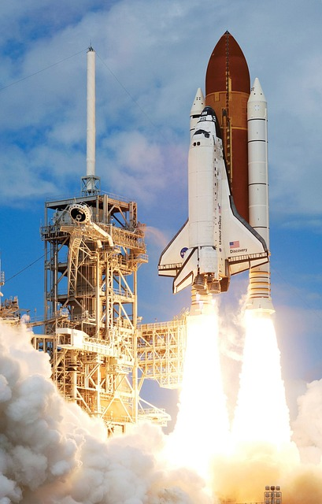
Acceleration
Acceleration can occur vertically as well as horizontally.
Newton’s First Law states that an object’s motion will not change unless acted upon by an unbalanced force.
This also applies to objects travelling up and down.
The same rules apply with velocity-time graphs when describing vertical motion.
Notes:
Exposition Type: Explanation
Suggested Exposition:
What is acceleration?
Acceleration is the rate of change of velocity.
What are the three different changes that acceleration can be used to describe?
Speeding up, slowing down and changing direction.
Acceleration can occur vertically as well as horizontally. This means that the velocity of objects travelling up and down can also change, as well as those travelling along the ground.
The same physical laws apply when thinking about objects moving vertically, usually it just means that we have different forces to consider.
What is the force that attracts all objects with mass towards the centre of the Earth?
Gravity
Gravity (weight) has to be considered when talking about objects moving or accelerating vertically.
What is Newton’s First Law?
An object’s motion will not change unless acted upon by an unbalanced force.
This law applies to objects travelling up and down as well as along the ground.
What will happen to the motion of an object if there is an unbalanced force acting upon it?
It will accelerate in the direction of the resultant force.
The same rules apply when looking at velocity-time graphs of objects moving vertically, the only thing that may be different is the direction. Remember that a negative velocity can be used to describe an object moving in the opposite direction - the same is true when thinking about vertical motion. Generally we use a positive velocity for an object travelling upwards and then a negative velocity for an object travelling in the opposite direction - downwards, although this is not always the case so it is important to look at the velocity-time graph first.
What does a horizontal line represent on a velocity-time graph?
An object with constant velocity
What does the gradient represent on a velocity-time graph?
The acceleration
What can be determined from the area under the velocity-time graph?
The distance travelled.
Notes:
This lesson should act as a consolidation of all the learning in this unit. You may want to allocate some of the time in this lesson to go over more examples of acceleration calculations. Other acceleration calculations are not introduced at this point as they will be covered in a later unit with stopping distances and applications of acceleration.
Vertical motion is a concept that is only returned to at A-Level so it is more important at this stage that pupils are able to interpret velocity-time graphs for horizontal motion and be able to explain these in terms of the forces acting on the objects.

Slide 13
Determine if the following statements are true or false:
Newton’s First Law states that an object’s motion will not change unless acted upon by balanced forces
The resultant force acting on a stationary object must be zero
The only force acting on an object that is falling is gravity
A negative velocity shows that an object is travelling in the opposite direction
False
True
False
True
Notes:
Purpose: review of new information.
False – unbalanced force
True
False – air resistance will also be acting but if the object is accelerating the resultant force is acting downwards (i.e. gravity is greater than air resistance)
True

Slide 14
Accelerating Upwards
Why does a space rocket need a lot of force to lift off?
What is Newton’s First Law?
What forces are acting on the rocket before lift-off?
What forces are acting on the rocket at lift-off?
What can be said about the size of these forces for the rocket to be able to lift off?
In which direction would the resultant force be acting?
Which direction would the rocket accelerate in?
Notes:
Guidance:
This is an opportunity to get pupils to think about the forces that would be acting on the rocket before they apply this to the velocity-time graph.
These questions can be edited to suit the needs of your class.
Key points:
Newton’s First Law states that an object’s motion will not change unless there is an unbalanced force acting on it.
Before lift off weight/gravity is acting on the object
At lift off there would still be weight acting, but there must also now be thrust
For the rocket to be able to lift off the force of thrust must be greater than weight
The rocket accelerates upwards because the resultant force is acting upwards
Stretch - what happens as the rocket accelerates?
As it accelerates, the force of air resistance increases
Eventually the forces of air resistance and weight will equal the thrust
Balanced forces mean the motion cannot change so it will continue moving at the same velocity

Slide 15
Drill
What is Newton's first law?
Describe the forces acting on a stationary car. When a car accelerates, what happens to the forces? What happens to air resistance as a car accelerates?
Which direction would air resistance act on a car moving forwards? What are the forces acting on a stationary rocket?
If a rocket initially accelerates upwards what does this tell you about thrust and weight? If a rocket runs out of fuel, what will happen to the thrust force? If a rocket is moving upwards and the weight is greater than thrust force, then what happens to the rocket? What is the force that attracts objects with mass towards the centre of earth?
Notes:
Purpose: This is a knowledge drill. The purpose of this is to check that the critical knowledge is secure before pupils move onto independent practice.
Suggested guidance: There are a range of ways this could be done depending on time and ability range of the class:
Mini whiteboards
As full sentences in exercise books
As short answers in exercise books
In the pupil workbook
As pair talk
As cold call

Slide 16
Drill answers
Newton's first law states that an object in motion will not change unless there is an unbalanced force acting on it. The resultant forces on a stationary car are 0N as they are equal and opposite.
When a car accelerates the forward force (thrust force from the engine) is greater than the backward force(friction and air resistance).
Air resistance increases as a car accelerates. Air resistance would act backwards when a car moves forward.
Stationary rocket has weight and reaction force.
Thrust is greater than weight when a rocket initially accelerates upwards. Thrust is removed when a rocket runs out of fuel.
The rocket will still move upwards but will then start to slow down, and then start to fall down, as the weight is greater than thrust.
Gravitational force.
Notes:
Purpose: This is a knowledge drill. The purpose of this is to check that the critical knowledge is secure before pupils move onto independent practice.
Suggested guidance: There are a range of ways this could be done depending on time and ability range of the class:
Mini whiteboards
As full sentences in exercise books
As short answers in exercise books
In the pupil workbook
As pair talk
As cold call

Slide 17
Acceleration Extended Response
Complete the extended response activity
Add labels to the graph to show key points
Describe the motion
Explain the changes in motion with respect to the forces acting on the rocket
Notes:
Purpose: apply new information
Teacher guidance provided in extended response document.

Slide 18
Answers
Part 1
Rocket runs out of fuel at 3 seconds (after which time it slows down)
Highest point reached is at 5 seconds (where the rocket will stop for a fraction of a second before changing direction and falling back down)
Rocket hits the ground just after 7 seconds (where its velocity suddenly decreases to 0)
Part 2
The rocket accelerates (uniformly) from 0 to 20 m/s in 3 seconds
Between 3 seconds and 5 seconds the rocket slows down (uniformly) to 0
Between 5 seconds and 7 seconds the rocket accelerates to 20 m/s in the opposite direction
After 7 seconds the rocket stops as its velocity decreases to 0
The rocket remains stationary until 10 seconds

Slide 19
Answers
Part 3
The rocket initially accelerates because the thrust force is greater than the weight/force of gravity
The rocket runs out of fuel so the thrust force is removed
This means that the weight is now the resultant force so the rocket accelerates in the direction of the resultant force
It was already travelling upwards, which means that its acceleration is now downwards (it is not moving downwards yet, it is still travelling upwards but slowing down)
It reaches the highest point when its velocity is 0 before turning around (the velocity has become negative)
The rocket accelerates downwards because the resultant force is still weight
The rocket hits the ground and the reaction force from the ground causes the rocket to stop
The resultant force of weight and reaction force becomes 0 so the rocket remains stationary

Slide 20
Answer the questions below.
Which scenario would have a non-zero resultant force?
A. An object travelling at constant velocity
B. A stationary object
C. An object decelerating
2. At what point would a rocket have a velocity of 0?
A. Just before it hits the ground
B. At its highest point
C. Just after it takes off
3. Which would show an object decelerating on a velocity-time graph?
A. A negative gradient
B. A positive gradient
C. A horizontal line at 0 on the y axis
✓
✓
✓
Notes:
Suggested Guidance:
Q1. Answer: C
If students answer A, they have not understood the relationship between force and motion and Newton’s First Law. To fix-it get pupils to state Newton’s First Law and explain what this means for objects that are stationary or already in motion.
Q2. Answer: B
If students answer A or C, they have not been able to visualise the motion of this rocket. To fix-it it may be useful to throw a ball up in the air and ask students when it has a velocity of 0.
Q3. Answer: A
If students answer B, they may not be clear on what deceleration means or what a positive gradient is. If students answer C, they have understood that this would show an object with a velocity of 0 but not understood that this itself does not show the deceleration. To fix-it you may want to get pupils to summarise the features of VT graphs and DT graphs in a comparison table.

Slide 21
Lesson P3.1.11
What was good about this lesson? | What can we do to improve this lesson?
Send us your feedback by clicking this link
or by emailing sciencemastery@arkonline.org
Thank you!

